Slide 1
Cellular Network
Govt. regulatory agencies could not make spectrum allocations in proportion to the increasing demand for mobile services
Restructuring of radio telephone system became imperative
  To achieve high capacity
  With limited radio spectrum
  Covering very large areas

Slide 2
The cellular concept
Replace a single high power transmitter (large cell) with many low power transmitter (small cells)
Each cell provides coverage to only a small portion of service area
Cellular concept was a major breakthrough in solving
  Spectral congestion
  User capacity

Slide 3
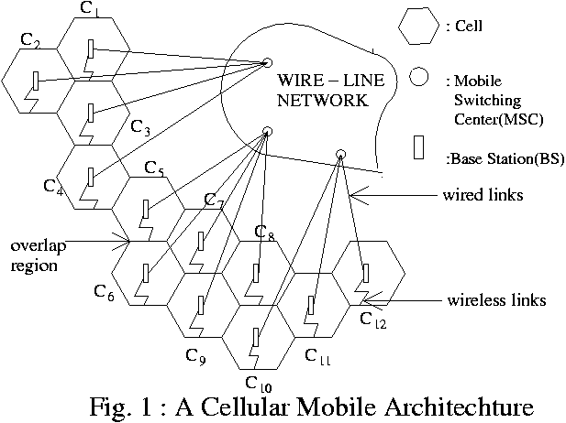
Cellular Architecture

Slide 4
terminology
Base Station (BS)
  A fixed station in a mobile radio system
  Used for radio communication with MS
  Located at the centre or on the edge of a coverage region
  Consists of
    Radio channels
    Transmitter
    Receiver
    antennas

Slide 5
terminology
Mobile Switching Centre (MSC)
  Co-ordinates routing of calls in a large service area
  Connects BS and MSs to the PSTN
  Also called mobile telephone switching office (MTSO)
Transceiver
  Device capable of simultaneously transmitting and receiving radio signals

Slide 6
terminology
Mobile Station (MS)
  Contains
    Transceiver
    Antenna
    Control circuitry
  Mounted in a vehicle
  Used as a portable hand-held unit
Forward Voice Channel (FVC)
  Channels used for voice transmission from BS to MS
Reverse Voice Channel (RVC)
  Channels used for voice transmission from MS to BS

Slide 7
terminology
FCC/ RCC
  Two channels responsible for initiating mobile calls
  Involved in setting up a call
  Often called set-up channels
  FCC serve as beacons
  Continuously broadcast all of the traffic requests for all MSs in the system
  5% of total channels available are control/ setup channels
A typical MSC handles
  100,000 cellular subscribers
  5,000 simultaneous conversation at a time
  billing and system maintenance functions

Slide 8
How a call is made ?
When a cell phone is turned on
  scans the group of FCC to determine the one with the strongest signal
  MS monitors the FCC until the signal drops below usable level
Call initiated by MS
  A call initiation request is sent on RCC
  The servicing BS receives this data
  Received data is sent to the MSC
  The MSC validates the request
  Makes connection to the called party through PSTN
  Instructs the BS and MS to move to an unused FVC and RVC

Slide 9
Call initiated by land phone
  MSC dispatches the request to all BSs
  Request message is broadcast as a paging message over all of the FCC
  The MS for which MIN is broadcast responds by identifying itself over RCC
  Servicing BS relays the acknowledgement to MSC
  MSC instructs the BS to move the call to an unused voice channel
  BS signals the MS to change frequencies to an unused FVC/ RVC pair
  An alert message is also sent by FCC to instruct MS to ring

Slide 10
Role of MSC during Call in progress
  apply special control signal to control MS by BS and MSC
  adjusts the transmitted power of MS
  maintain call quality by changing the channel of MS

Slide 11
Cell Shape
Actual radio coverage of a cell is known as footprint determined from
  field measurements
  propagation prediction models
Real footprint is amorphous in nature
Regular cell shape is essential for
  systematic system design
  future growth

Slide 12
Cell Shape
Regular shapes
  rectangle
  circle
  hexagon
For a given distance between the centre of a polygon and its farthest perimeter points
  hexagon has the largest area of the three
  hexagon closely approximates a circular radiation pattern matches with
    omni-directional BS antenna
    free-space propagation

Slide 13
Frequency reuse
Place BSs systematically
Distribute channel groups throughout the coverage zone
Channels are reused as many times as necessary
  Interference between co-channel cells should be below acceptable level

Slide 14
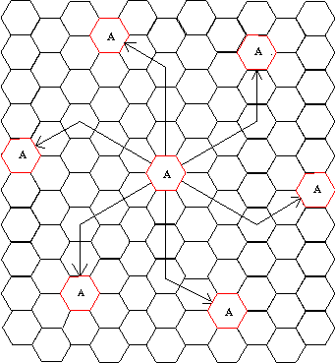
Co-channel cells
Cells labeled with ‘A’ use the same group of channels
No. of cells per cluster/ compact pattern N
N = i² + ij + j²
i=3, j=2; N=19
Each cell has 6 equidistant neighbour
Fig. 2 : Calculation of co-channel cells

Slide 15
Nearest co-channel neighbours
Find the nearest co-channel cells
  move i cells along any chain of hexagons
  turn 60⁰ counter-clockwise
  move j cells
Co-channel interference
  Interference between signals of a cell and its co-channel cells is called co-channel interference

Slide 16
Cell Design
Let a cellular system has
  total of S duplex channels
  each cell is allocated a group of K channels
  N cells are in a cluster
S = KN
A cluster is replicated M times
Total no. of duplex channels
C (capacity) = MKN = MS

Slide 17
Cell Design
Capacity is directly proportional to the no. of times a cluster is replicated
A large cluster size indicates
  Ratio between the cell radius and the distance between co-channel cells D/R is large
A small cluster size indicates
  Co-channel cells are located much closer
  Co-channel interference is significant

Slide 18
Cell Design
Design criteria (over a given coverage)
  maximise capacity
    smallest possible value of N
  no interference
    biggest possible value of N
  tradeoff between capacity and interference/QOS

Slide 19
Co-channel interference and system capacity
co-channel interference Q = D/R (see Fig)
  Q is too large
  Improves the transmission quality
  Q is too small
  Capacity increases
Trade-off must be made between quality and capacity
Reduce co-channel interference
  Separate co-channel cells by a minimum distance
  Provide sufficient isolation due to propagation

Slide 20
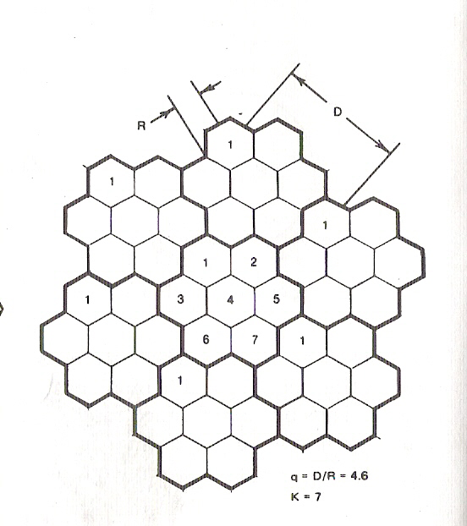

Slide 21
Hand Off strategies
The process of transferring a mobile station from one channel or base station to another
  Identify a new BS
  Voice and control channels be allocated to channels associated with new BS
Hand off must be performed
  Successfully
  As infrequently as possible
  Imperceptible to the users

Slide 22
In order to meet these requirements
  System designer must specify an optimal signal level to initiate a hand off
  Specify a particular signal level as minimum usable signal for acceptable voice quality at BS receiver
  A slightly stronger signal level is used as threshold
  This margin is given by
  delta = P_{rhandoff} – P_{rminimum usable}

Slide 23
Delta is too large
  Unnecessary handoffs which burden the MSC may occur
  Delta is too small
  insufficient time to complete a handoff before a call is lost due to weak signal

Slide 24
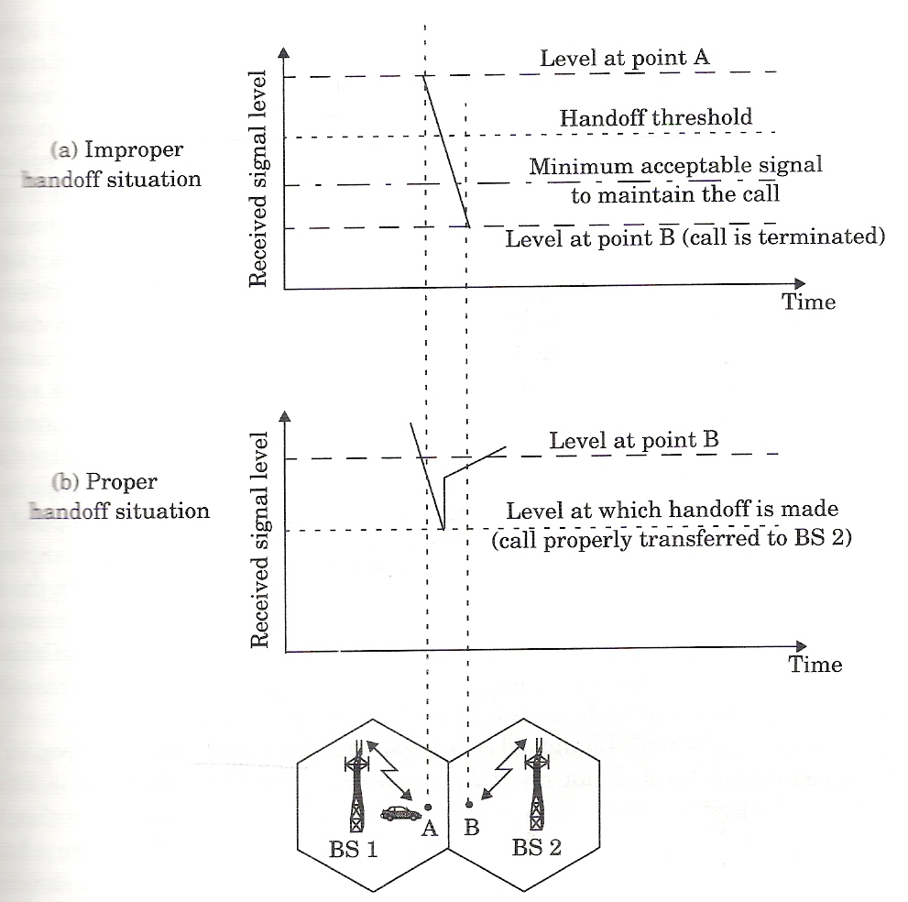
Fig. 3 : Illustration of a handoff scenario at cell boundary

Slide 25
Call may be dropped for the following reasons
Excessive delays may occur during high traffic condition for following reasons
  computational loading at MSC
  no channels are available on any of the nearby BSs
  forces MSC to wait until a channel in a nearby cell becomes free

Slide 26
Ensure the following before handoff
  The drop in the measured signal level is not due to momentary fading
  MS is actually moving away from the serving BS
In order to ensure this
  BS monitors the signal level for a certain period of time before a handoff is initiated
    Duration of time depends on speed of MS
    If the slope of the short-term average received signal level is steep, hand off should be made quickly

Slide 27
1st generation hand off
  BS measures signal strength (ss)
  MSC supervises
  Each BS constantly monitors ss of RVCs
  Determine relative location of each MS
2nd generation hand off
  Hand off decisions are MS assisted (MAHO)
  MS measures the received power from neighboring BSs
  Continually reports the measurements to the serving BS

Slide 28
  A hand off is initiated
    Power received from the BS of a neighbouring cell > power received by the current BS by a certain level or for a certain period of time
Merits of 2nd gen hand off
  Hand off is made by each MS
  MAHO hand over a call much faster
  MSC no longer constantly monitors ss

Slide 29
Roaming
Roaming is a mechanism by means of which intersystem hand off takes place
When roaming ?
  Ss received by MS becomes weak
  MSC can’t find another cell within its system to transfer the control of MS
What are the issues of roaming ?
  MS moves out of its home system
  Local call becomes long distance call
  Compatibility between the two MSCs must be determined before implementing an intersystem hand off

Slide 30
Prioritizing hand off
User’s view
  A call abruptly terminated while in the middle of a conversation is more annoying than being blocked occasionally on a new call attempt
  Hand off prioritization over new call attempt is desirable
Solution ?
  Guard channel concept
    A fraction of channels is reserved for hand off
  Queuing of hand off requests

Slide 31
Hand off – some of the practical constraints
Problem 1
Accommodating a wide range of mobile velocities during design
Solution ?
  Use different antenna heights
  Use different power levels
  Provide ‘large’ and ‘small’ cells co-located
  Known as umbrella cell approach (see Fig)
  Large/small area coverage to high/low speed users

Slide 32
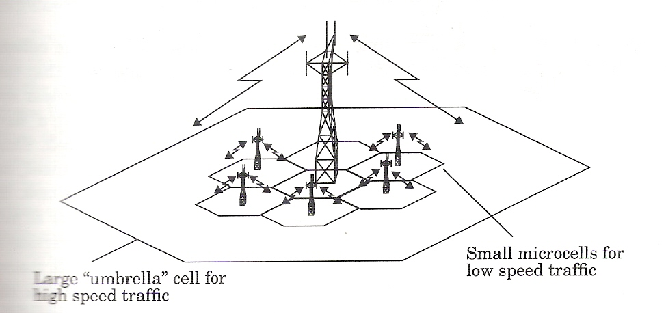
Fig. 4 : The umbrella cell approach

Slide 33
Problem 2
Cell dragging
  Hand off is not made even when essential
  results from pedestrian users providing very strong signal to the BS
  occurs in an urban environment
  LOS radio path exists between MS and BS

Slide 34
GSM
GSM (Global System for Mobile) is a 2nd generation cellular system standard
World’s first cellular system to specify digital modulation and network level architectures and services
Before GSM, European countries used different cellular stds throughout the continent
  Not possible for a customer to use a single subscriber unit throughout Europe

Slide 35
GSM contd.
GSM services and features
  Classified as either teleservices or dataservices
Tele services
  Calling
  Fascimile
Data services
  Data rates from 300 bps to 9.6 kbps
  SMS while simultaneously carrying normal voice traffic

Slide 36
GSM contd.
Remarkable features from the user’s point of view
SIM is a memory device that stores following information
  subscriber’s identification module
  Networks
  Country
  Privacy key
  Other user specific information

Slide 37
GSM contd.
Without SIM installed all GSM mobiles are identical and nonoperational
Subscriber may plug their SIM into any suitable terminal

Slide 38
GSM contd.
GSM system architecture consists of three major interconnected subsystem
  Base Station Subsystem (BSS)
  Network and Switching Subsystem (NSS)
  Operating Support Subsystem (OSS)

Slide 39
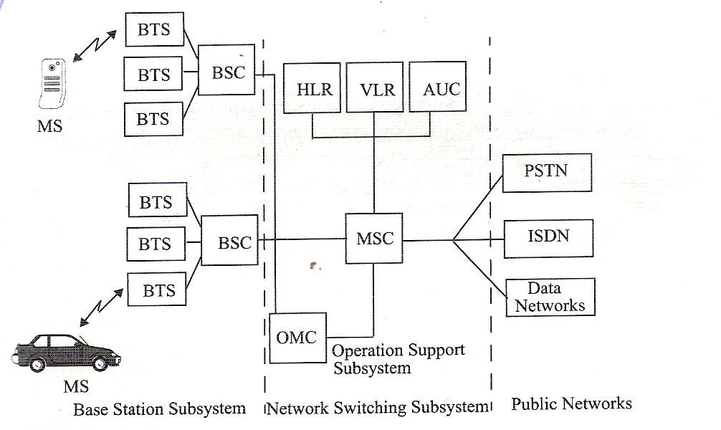
Fig. 5 GSM system architecture

Slide 40
GSM contd.
BSS provides
  Radio transmission paths between the MS and MSCs
  Manages the radio interface between the MSs and all other subsystems of GSM
  BSCs connect the MS to the NSS via MSCs
NSS manages
  Switching functions of the system
  Allows the MSCs to communicate with other networks (PSTN, ISDN)

Slide 41
GSM contd.
OSS supports
  Operation and maintenance of GSM
  Allows system engineers to monitor, diagnose and troubleshoot all aspects of the GSM
  Solely for the staff of the GSM operating company
Mobile handoffs between two BTSs under the control of the same BSC are handled by the BSC, and not the MSC

Slide 42
GPRS
GPRS (General Packet Radio Service)
Multicast packet switched technology
Enhanced 2nd generation cellular system with faster data service
Particularly suited for sending and receiving small bursts of data such as email and web browsing

Slide 43
GPRS contd.
Runs at speed up to 115 kbps compared with 9.6 kbps
  Promises to support data transmission typically at 20 to 30 kbps (max 50 kbps)
  Theoretically max up to 171.2 kbps
Pay only for the amount of information you download rather than duration of the connection

